Slide 1




DESIGN AND IMPLEMENTATION OF A SECURE COMPANY NETWORK SYSTEM

Slide 2


CONTENT
01
02
03
04
05
Introduction
Network Topology
Security Design Approach
IR & DR & BC
Monitoring and Control
06
07
08
09
10
Network Security Measures
Awareness and Training Programs
Our Team
AAA Server
SOC Requirements

Slide 3

INTRODUCTION
Title
Overview of the project and its goals
Tools used: Packet Tracer

Slide 4


NETWORK TOPOLOGY
Go to Paket Tracer >>>

Slide 5



SECURITY DESIGN APPROACH
01
Physical Security Controls
Example: Secure access to server rooms
02
Technical Security Controls
Use of firewalls, IDS/IPS(Intrusion Detection and Prevention Systems), VPNs
03
Administrative Security Controls
Security policies, user training

Slide 6

IR & DR & BC
Incident Response, Disaster Recovery, Business Continuity
Different IR, DR, and BC plans implemented
How the network can recover from potential disruptions

Slide 7




MONITORING AND CONTROL
Network monitoring: How the SOC monitors network traffic and device status.
Using tools to collect logs and analyze them
User behavior analysis

Slide 8

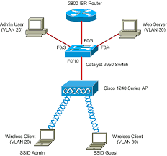
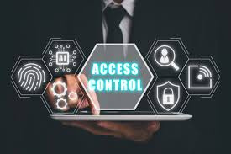

NETWORK SECURITY MEASURES
Protection Against External Attacks
Securing Internal Communications
Preventing Internal Attacks
Firewalls, VPN encryption for branches.
VLANs for department isolation.
Access controls, user activity monitoring

Slide 9

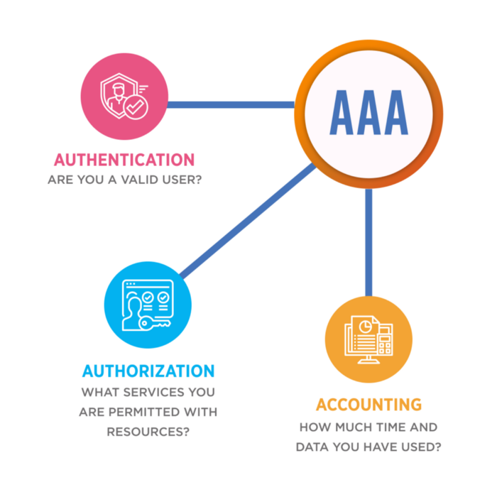
AAA SERVER:-
Authentication
Authorization
Accounting

Slide 10


SOC REQUIREMENTS
Monitoring Network Traffic
Dani Martinez
Collecting Logs
Log Analysis
Mitigation Strategies

Slide 11
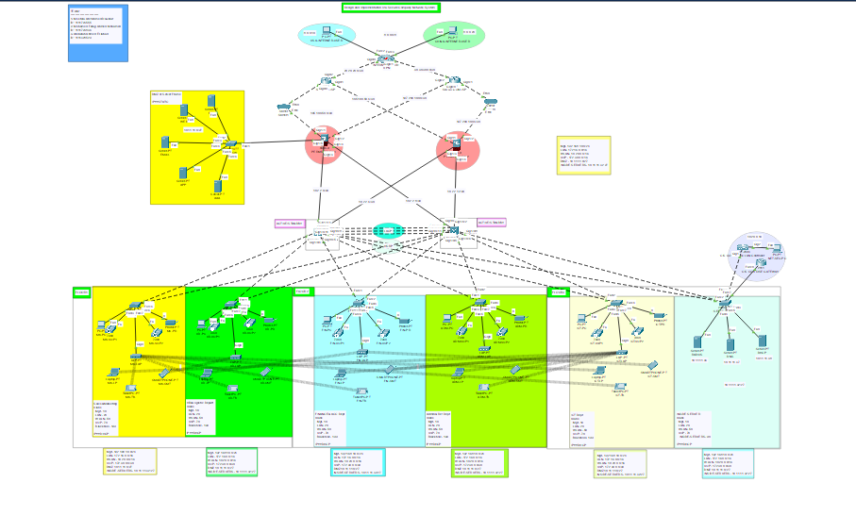
AWARENESS AND TRAINING PROGRAMS
Protecting Weak Points:-
User training, attack simulations, and the use of a proxy server.

Slide 12



OUR TEAM
Mostafa Atef
Network Secuirty
linkedin.com/in/mostafa-atef
Mohamed Farag
Network Secuirty
linkedin.com/in/mohamed-farrag

Slide 13
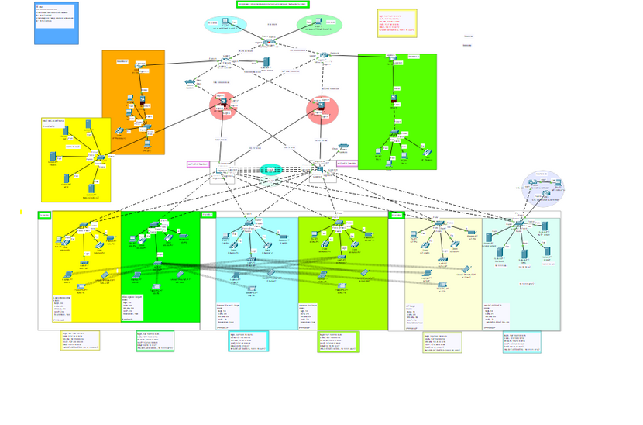
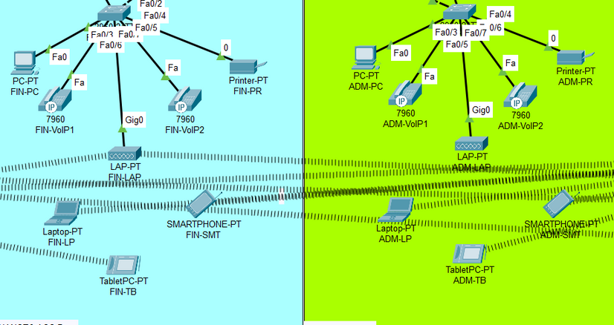
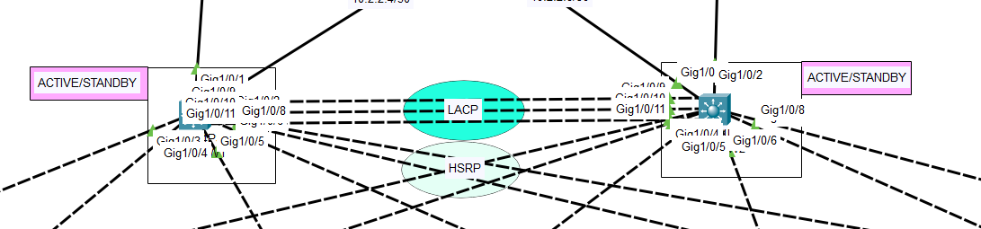
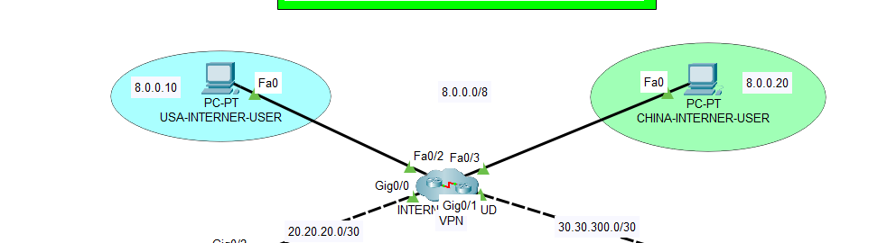
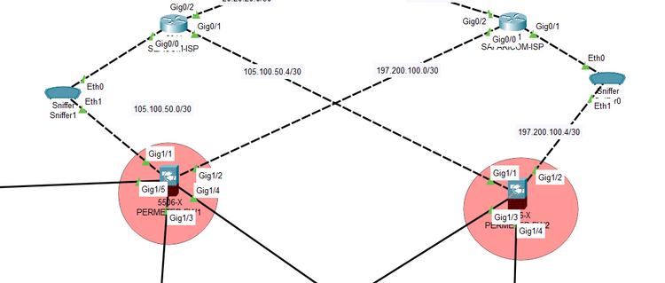
THANK'S FOR WATCHING

